Slide 1
The package approach to competitive procurement: experiences in Zambia, Senegal, and Morocco
July 19, 2019

Slide 2
Agenda
The challenge: perception of high risk and transaction costs constrain RE development.
Package approach 1: IFC’s Scaling Solar program in Zambia and Senegal.
Package approach II: Morocco’s wind and solar programs.
Lessons learned

Slide 3
1. Cost reduction brought RE from alternative to mainstream, yet challenges remain
Attracting private investment for RE development is needed to:
Meet increasing electricity demand
Support cash-strapped utilities in the generation segment
Need
High perceived risk and cost of capital (off-taker risk, political risk)
High transaction costs to complete due diligence.
Challenge
Auction design
De-risking mechanisms
Standardized documentation
Package approach

Slide 4
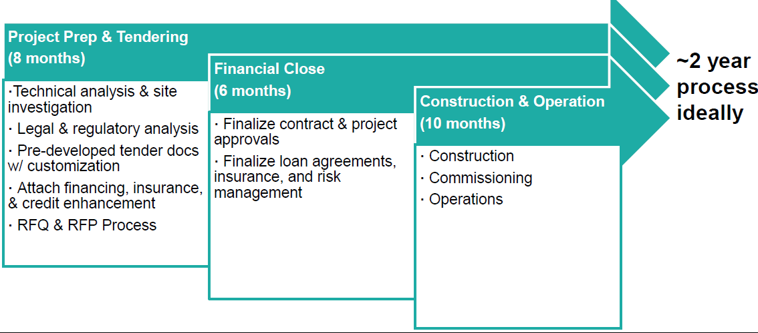
2. IFC‘s Scaling Solar offers a „one-stop-shop“ solution to competitive procurement
Several WBG instruments brought together under a single product offering, design & implementation covered by a single mandate.
Sample implementation timeline
Source: Blue Horizon based on World Bank Group

Slide 5
2. The Scaling Solar Program uses standardized documentation
What are the “template documents”?
Engagement Letter & ToRs for specialized Consultants
Power Purchase Agreement & Government Support Agreement
Pre-Qualification Document & Request for Proposals
Letter of Interest and Indicative financing terms
Government signs a Letter of Engagement with IFC’s Advisory Services
A World Bank Group team is put in place
Specialized consultants are hired based on existing Terms of References
Documents designed as fair, balanced & bankable.
Tendering documents are ready and have been designed to attract top tier developers and investors
Indicative terms for debt financing as well as terms for Partial Risk
Guarantees are available and have been through preliminary internal approvals
Source: IFC Scaling Solar

Slide 6
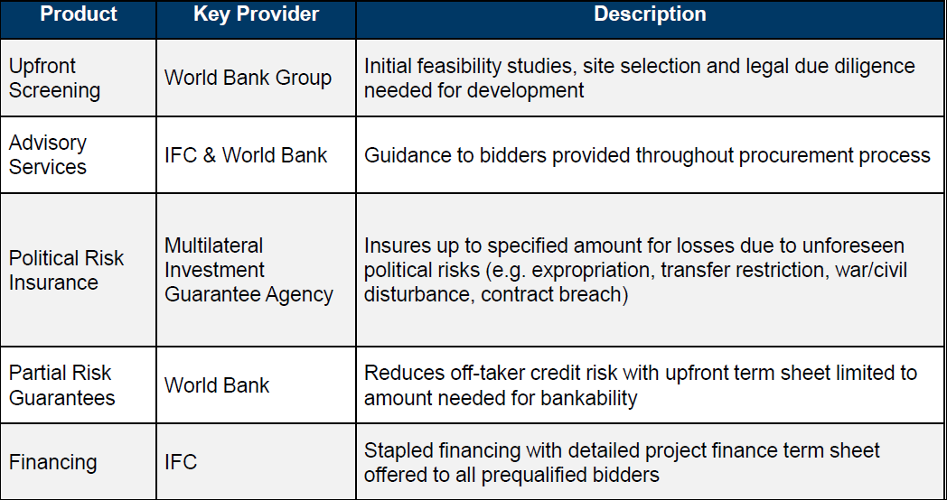
2. The program’s de-risking approach covers transaction services, guarantees and stapled financing
Source: Blue Horizon based on World Bank Group

Slide 7
Example of stapled financing: Zambia
Offered to all pre-qualified bidders but it is not mandatory
Structured in three tranches – IFC does not cover the entire loan portfolio:
Tranche 1: debt on commercial terms
Financing usually offered with shorter tenor, 5-7 years from local commercial investors in SSA countries
Tranche 2: debt on concessional terms based on available grant funding (lower interest rate and/or higher tenor).
Tranche 3: needs to be sourced by bidders from other financiers, whether commercial banks, export credit agencies or other sources.
Source: IRENA 2018

Slide 8
Example of concessional elements and tariff reduction in Zambia 1
Concessional element | Estimated tariff reduction
33% concessional loan tranche (LIBOR flat) | 0.5 c/kWh
33% OPIC financing (longer tenor) | 0.3 c/kWh
PA-funded development costs ($2m) | 0.2 c/kWh
TOTAL TARIFF REDUCTION | 1.0 c/kWh
Source: WBG Scaling Solar

Slide 9
Experience in Zambia: auction results
9months: Project preparation, tender delivery and award
Top 6 bids for the West Lunga Site | Mosi-oa Tunya Site
Neoen | First Solar: 6.015USc/kWh*| 6.135USc/kWh
ENEL Green Power: 7.799USc/kWh | 7.839USc/kWh*
Access | EREN Zambia 1: 8.288USc/kWh | 8.951USc/kWh
MULILO Zambia PV1 Consortium: 8.400USc/Kw h | 8.400USc/kWh
EDF Energies Nouvelles: 10.040USc/kWh | 9.985USc/kWh
SEP | AVIC Intl: 10.600USc/kWh | 10.600USc/kWh
6.0USc/kWh non-indexed is equivalent to an average in current dollars over contract life of 4.7USc/kWh
*Winning bids
Source: IFC Scaling Solar

Slide 10
Lack of coordination processes among implementing bodies can cause delays
 | Zambia¹: Example round 1 | South Africa²: Example round 1
Lead time auction design and bid submission | ~6 months, from IFC mandate signature to RfP issue. | ~9 months, from DOE IPP office creation in November 2010 to RfP issue.
RfQ issued | October 2015 | See below
RfP issued | February/March 2016 | August 2011: combined RfQ and RfP
Bid submission | April 2016 | November 2011
Award | May 2016 | December 2011
Financial close | Planned: 6 months after award (November 2016) Actual: December 2017 (Neoen project) / June 2018 (Enel project) | Expected 9-12 months after award Actual: November 2012 (11 months)
Construction | Planned: 10 months after financial close. Actual: +13-18 months of planned date. | Expected 24-30 months after financial close (solar PV, onshore wind, biomass) Actual: December 2014 (24 months).
Take-aways | Implementation timeline was not met → delay in reaching financial close of 13-18 months over initial 6-month period. Lack of previous coordination processes among implementing bodies. Limited understanding of specific requirements regarding the project site and regulation (e.g. grid code). | +90% of projects from rounds 1-3 realized on time. Yet timeline implementation delayed due to ESKOM: Experiencing delays issuing budget quotes for grid connection to preferred bidders. Suspending the signing of the PPAs in round 4 for ~2 years.

Slide 11
Experience in Senegal: auction results
60% tariff reduction achieved in Senegal.
Top 6 bids for the Kahone | Touba Site
ENGIE | MERIDIAM: 3.802€c/kWh*| 3.983€c/kWh*
Nareva Holding | Abu Dhabi Future Energy Company PJSC “Masdar”: 3.890€c/kWh | 3.990€c/kWh
Access Infra Africa | Total Eren S.A 4.390€c/kWh | 4.390€c/kWh
Actis Energy 4 | Mulilo Group Holdings Proprietary Limited: 4.504€c/Kwh | 4.889€c/kWh
Scatec Solar: 4.600€c/kWh | 4.630€c/kWh
Acciona Energia SA: 5.793€c/kWh | 5.164€c/kWh
3.8€c/kWh (4.7USc/kWh) indexed at 1.2% is equivalent to an average in current dollars over contract life of 4.3USc/kWh
*Winning bids
Source: IFC Scaling Solar

Slide 12
3. Morocco’s package approach lowers risks through a credible off-taker project co-ownership
Low risks and costs of development:
Single-item auction, providing for site and grid connection.
Bidders are shielded from certain risks, which can help reduce barriers to entry (especially in a nascent market) and bidders.
Credibility of off-taker (ONEE)
No history of payment defaults.
Morocco has already shown its commitment to wind power by developing 800 MW of capacity (IRENA, 2017), some of which was awarded through auctions with ONEE (national utility) as off-taker.
Public-private partnership increases investor confidence
Projects awarded will be built under a PPP with ONEE, the Energy Investment Company (SIE) and the Hassan II Fund for Economic and Social Development, will jointly hold a 35% share in each of the five projects.
Private partners hold the remaining 65% (Enel Green Power, 50%).

Slide 13
3. Concessional financing and enabling political environment increase trust in the process
International financial institutions
Concessional finance from IFIs to MASEN/ONEE enables favorable prices.
Wind: ONEE secured €385 ($408) million of debt for 5 projects totaling 850 MW (Total investment = €1.24 billion)
Solar: MASEN secured $964 million for the Ouarzazate project.
Enabling political environment
Strong political leadership for renewables streamlines national agencies’ agendas; creation of specific agency.
Stable political and regulatory environment and experience with IPPs essential in attracting investors.
The wind auction is part of a plan to deliver a wind target of 2 GW by 2020, providing investors with a strong signal for market development.
Source: Navigant--A Guidehouse Company, IRENA

Slide 14
3. Build-up of complex structures led to lengthy procurement process in the case of wind
Although organizing the auction in an experienced and specialized entity helped streamline processes, there were drawbacks:
ONEE was given many roles in the process: awarding authority, main investor and lender.
The multiple roles ONEE took in the transaction required the build-up of complex procedures and corporate structures
It took almost 7 years from the publishing of the project to the contraction of agreement
Source: Navigant--A Guidehouse Company, RES4MED

