Slide 1
Getting project location right: locational signals
July 17, 2019

Slide 2
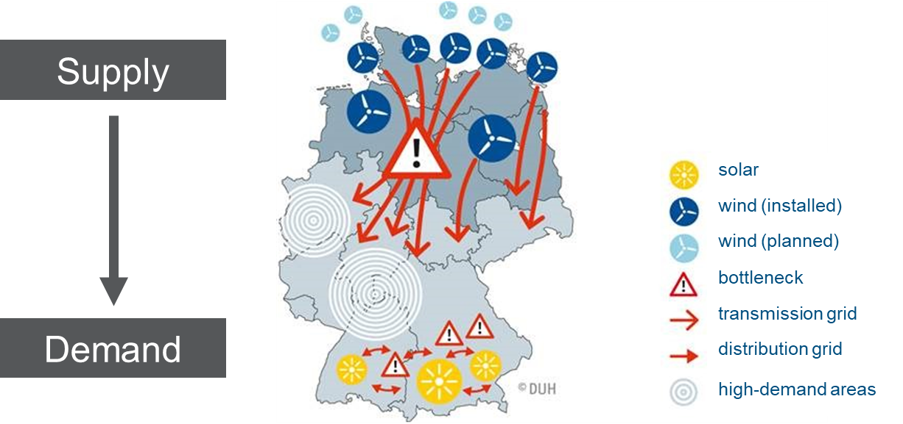
System integration becomes more relevant with an increasing share of renewable energy
New challenges emerge
System integration costs and policy/support costs are different.
System integration readiness: Insufficient capacity to connect electricity supply and demand
Example: Germany
In developing countries with increasing energy demand, stress on the grid is accentuated as RE deployment gains pace.
+ | Cost of capital (debt, equity)
= | Electricity production costs (focus of policy/support costs)
+ | Grid expansion costs related to RE
+ | Costs of control and balancing energy related to RE, including the provision of capacity
+ | Transaction costs
+ | Producer rent
= | System costs of RE generation

Slide 3
Locational signals: Why are they important
Overall: Good to have a general strategy on how to site projects, locational signals become particularly important if high RE and/or weak grids
Site-agnostic schemes tend to concentrate the development of projects to resource-rich locations, which can overload the grid infrastructure and create competition for land usage.
Aim of locational signals: Steering the construction of projects to specific areas to avoid the concentration of projects in certain areas (e.g. due to system integration concerns)
Options for locational incentives could include
bonus/penalty to bids located in areas with available/insufficient grid capacities
RE development zones
maximum capacity quotas in certain areas
site-specific auctions

Slide 4
A continuum of incorporating locational steering in competitive procurement design
Site-agnostic auction
RE projects are built everywhere (i.e. best resources sites)
Bid bonus/
penalty
Bonus applied to bids in places with available grid capacity or power capacity needs
REDZ
Zones with simpler environmental/grid connection approval process
Maximum capacity quota
Capacity limits (quotas) are defined in certain areas
Site-specific auction
Authorities select a site according to grid and land availability
Hard locational signals
No locational signals
Most RE auctions
Germany, Mexico
South Africa
Kasachstan, Germany
Zambia, Germany

Slide 5
Bid bonusses and penalties reflect the value of electricity or grid restrictions
Bid bonus/
penalty
Bonus applied to bids in places with available grid capacity or power capacity needs
Mexico – „Expected price differences“
+
5€/ MWh
35€/ MWh
40€/ MWh
5€/ MWh
40€/ MWh
-
35€/ MWh
Gebot 1, price zone A
Adapted bid price
Gebot 2, price zone B
Adapted bid price
No locational signals
Germany, Mexico
Germany – „Distribution network component“ Joint auctions wind and solar PV
Malus for bids in areas, where additional RE capacities would require grid extension

Slide 6
Different zones have different capacity quotas
Kazakhstan – Segments <10 MW
District | Substation | Max. grid capacitiy | # new grid connections
Astrakhanskiy district | Urman | 7 MW | -
Sandyktauskiy district | Balkashino | 7 MW | -
District - Gabit Musrepov | Kuibyshevskaya | 14 MW | -
Maximum capacity quota
Capacity limits (quotas) are defined in certain areas
Germany – Onshore wind
„Grid extension area“: up to 900 MW may be added
2800 MW yearly auction volume
Hard locational signals
Kazakhstan, Germany
Quellen Bayan 2018 (USAID); BNetzA

Slide 7
Site-specific auctions can effectively take grid restrictions into account
Zambia – “Scaling Solar“ / Germany – Offshore wind
Site-specific auction
Authorities select a site according to grid and land availability
Auctioneer
Pre-development by authorities may entail:
Project site
Bidder 1
Selected & pre-developed
Grid connection
Environmental assessment
Resource assessment
Lease contract
Bidder 2
Bidder 3
Bidder 4
Hard locational signals
Zambia, Germany

Slide 8
How to create meaningful locational signals (1/III)
Benefits of locational signals | Reduced total system costs by identifying an optimal trade-off between required grid extensions/reinforcements and RE generation costs
Tool | Production Cost Modelling Tool which optimizes the unit commitment and economic dispatch of the power generation fleet taking into account transmission constraints of the grid
Key input data | Todays and future expected hourly load time series for each node of the transmission grid Techno-economic parameters of power plants connected to each system node incl. installed capacity, fuel cost, efficiency, min. stable generation level, max. ramp-rates, must-run requirements, etc.) Transmission capacity between nodes of the transmission system Potential hourly RE generation over the year Ideal case: hourly time-series available for each node of the transmission system

Slide 9
How to create meaningful locational signals (1I/III)
Output for each investigated scenario | Total annual system costs Optimal hourly dispatch schedule for power plants at each node of the system Hourly power transmission between system nodes and grid congestion Hourly locational marginal prices (LMP) for each system node Comparing results between investigated scenarios shows saving/additional costs if RE project is installed at system node A compared to system node B or even not at all Based on results, locational signals (bonus/malus) can be defined

Slide 10
How to create meaningful locational signals (1II/III)
Translating optimal location out into incentives
Price-based: bonus/malus
Objective: define at which nodes bid bonus or malus is applied. Cost delta between base case (no optimization of RE location) and optimal case for each system node: If lower cost: bonus applied to bids at that node Level of bonus < node cost delta (otherwise no savings for consumers)
Quantity-based: capacity quota
Objective: Identify maximum wind or solar capacity in certain system nodes Several options: Ex.1: define capacity quotas at all nodes (based on the output of the modeling) Ex.2: allow 10% of target RE capacity to be built at best resource sites → Define optimal capacity allocation for the remaining 90% of target RE capacity

Slide 11
Effectiveness of instruments is influenced by a lack of resources or lack of information available to authorities
Site-specific tenders: lack of resources available to authorities
Morocco and UAE: The sites for solar projects were selected as part of a plan that accounted for the investments needed in grid infrastructure.
Quotas: lack of oversight over the whole system
Grid operator needs to have knowledge of connection conditions and available capacity for each substation, coordination with auctioneer is also key.
Bonus: lack of information with sufficient spatial resolution on system integration costs
System integration cost data would need to be modelled to identify the need for more regional or time-based tariff differentiation.
Be aware! Inadequate government planning can increase project costs, support costs and overall system costs.

Slide 12
Exercise 3: Designing an auction with locational steering
Interactive Session
July 17, 2019

Slide 13
Interactive Session: Instructions
Interactive Session
AIM: Identify suitable auction design choices for fictive countries
Activity: Groups with 7-9 participants from difference institutions represent one fictional case country and identify suitable design from a “menu” of design choices
Appoint someone from your group to guide the discussion and present the findings
Note down key findings from your discussions on the assignment sheets
Timing: 20 minutes design within group, 40 minutes presentation & discussion with large audience

Slide 14
Interactive Session - Instructions
Interactive Session
Please discuss to advantages and disadvantages of the different options to include locational signals and recommend a locational signal for your fictitious country:
A)
Site-agnostic auction
RE projects are built everywhere (i.e. best resources sites)
B)
Bid bonus/
penalty
Bonus applied to bids in places with available grid capacity or power capacity needs
C)
REDZ
Zones with simpler environmental/grid connection approval process
D)
Maximum capacity quota
Capacity limits (quotas) are defined in certain areas
F)
Site-specific auction
Authorities select a site according to grid and land availability

Slide 15
Interactive Session – list +/- of the different options for different countries and recommend one
Country | Site-agnostic auction | Bid bonus/ penalty | RE Develop. Zones | Maximum capacity quota | Site-specific auction | Your choice for country
Country 1
Country 2
Country 3
Country 4

Slide 16
Interactive Session – Case countries (1/11)
Interactive Session
Country 1
Regional variation of RE resources, excellent RE resources in West, very good reserves in East and North, medium-quality RE resources in South Most demand centers and industry are located in the East of the country Transmission lines linking the country exist but wave rather small capacities Transmission line extension between West and East is planned, but will approximately take 9 years, transmission line extension between North and East is planned, but will take approximately 6 years. Grid capacities within East are strong Government does not own much land with good RE resources
Country 2
RE resources (solar and wind) as well as demand centers (cities, industry) distributed evenly over the country Transmission lines linking the country exist and still have capacity to include more RE Clarity for bidders on rules & regulation Already several project developers active with some already pre-developed projects

Slide 17
Interactive Session – Case countries (11/11)
Interactive Session
Country 3
Large country with vast land. Strong regional variation of RE resources between and within regions. Transmission lines linking the country exist but wave rather small capacities An additional transmission line extension is in construction and to be commissioned in 4 years Permit for RE projects are complex to obtain Government owns land with high RE resources close to new transmission lines
Country 4
Large country with vast land. Not strong regional variation of RE resources. Most demand centers and industry are in the East of the country Transmission lines linking the country are rare, two new transmission lines with higher capacity connecting the North with the East with new substations have just been commissioned There is overcapacity in the South of the country

