Slide 1

Business Support Organizations Champions
Goals
Improved business resilience for better economic shock mitigation on micro, small, and medium enterprises.
Promote women’s economic empowerment and economic equity.
Duration
September 2022–August 2026
Total Funding
$999,996
Implementing Partner
Strategic Development Consulting
Key Counterparts
Ministry of Economy
Ministry of Labor and Social Policy
Public-Private Dialogue Platform
Contact
Kristina Deriban
Email kderiban@usaid.gov
CHALLENGES
In North Macedonia, micro, small, and medium enterprises (MSMEs) are a major engine of growth and employment. Despite their potential, these businesses struggle to improve productivity, increase competitiveness, and harness talent. At the same time, women in North Macedonia are not economically empowered to take on managerial positions—they receive unequal pay and fewer jobs are available to them in highly paid industries.
Business support organizations provide services to help businesses grow and become more competitive. Though fragile, these organizations demonstrate potential to contribute to the country’s economic future, specifically through providing services tailored to women and to MSME needs.
ACTIVITY DESCRIPTION
This activity provides assistance to a targeted number of business support organizations to improve existing services, establish new business services, help clients overcome the negative impact of the overall economic crisis and promote women’s economic empowerment and economic equity. Through this activity, USAID also conducts policy analysis and develops recommendations to support government efforts to strengthen MSME resilience in the face of economic crises.
7%
27%
EXPECTED OUTCOMES
Steady economic growth in micro, small, and medium enterprises.
Improved business performance and productivity among MSMEs.
Empowered BSOs that create a conducive business ecosystem where
MSMEs can thrive and contribute to economic development.
Increased uptake of business services related to gender balanced
practices and related best practices adopted by MSMEs.

Slide 2

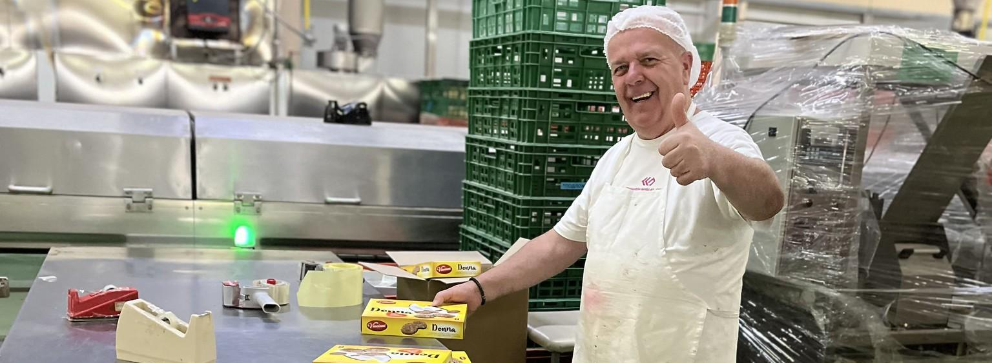
KEY RESULTS
ACCOMPLISHMENTS
Additional Business Services
Since October 2022, a total of 22 new and enhanced services for micro, small, and medium enterprises have been successfully established by business service organizations, directly addressing the specific needs of their members.
134 private sector enterprises were engaged through the activities of this project.
94 private sector firms improved their management practices through business support organization services.
78% of business service organizations reported improvement in working processes, management practices know how, and skills development of their personnel.
Operating Environment
Following comprehensive policy analysis,
three policy briefs were developed
and submitted, enabling the government
to enhance support mechanisms for MSME
resilience amidst economic crises. Additionally,
activity partners developed and presented an
initiative for changes in Trade Law to introduce the
Variable Capital Company as a new type of entity.
Last updated: October 2024

