Slide 1
Make a Difference
Goal
Improve the environment for community led development.
Duration
August 2022–August 2027
Total Funding
$1,982,367
Implementing Partners
Local Community Development Foundation
Key Counterparts
Rotary Club Kochani-Vinica
Rotary Club Shtip Local municipalities of Kochani, Shtip, Vinica, Karbinci, Delcevo, and Makedonska Kamenica
Contact
Edin Shabani Email eshabani@usaid.gov
CHALLENGES
Most citizens do not contact their local governments to discuss issues of concern. Though municipal authorities may verbally agree to citizen priorities, they often do not act upon them. Therefore, citizens are not proactive and remain reluctant to initiate policy improvements. Community members currently lack opportunities to get to know each other better, understand each other‘s needs and priorities, and build common ground for cooperation and development.
ACTIVITY DESCRIPTION
This activity will work in nine municipalities in the eastern region of North Macedonia to empower local actors to take the lead in identifying and addressing development challenges in their own communities. The activity works through “community colleges” and “youth banks” to bring community members together to identify, prioritize, and implement community actions, and come up with creative ways to mobilize resources. Community colleges are comprised of prominent community members that local citizens know and trust, including religious leaders, private business owners, and school directors. The youth banks are led and facilitated by youth, focusing on issues of concern to young people. They focus on knowledge and skills development, encouraging youth to become active citizens who lead positive changes in their communities.
7%
27%
EXPECTED OUTCOMES
Improved ability of local actors to engage citizens and relevant stakeholders.
Increased number of effective local partnerships among local actors.
Local actors will increasingly identify and prioritize community issues and opportunities.
Increased mobilization of all types of resources for local development such as funding, in-kind, and labor.
Sustainable locally led development models will be replicated in other communities.

Slide 2
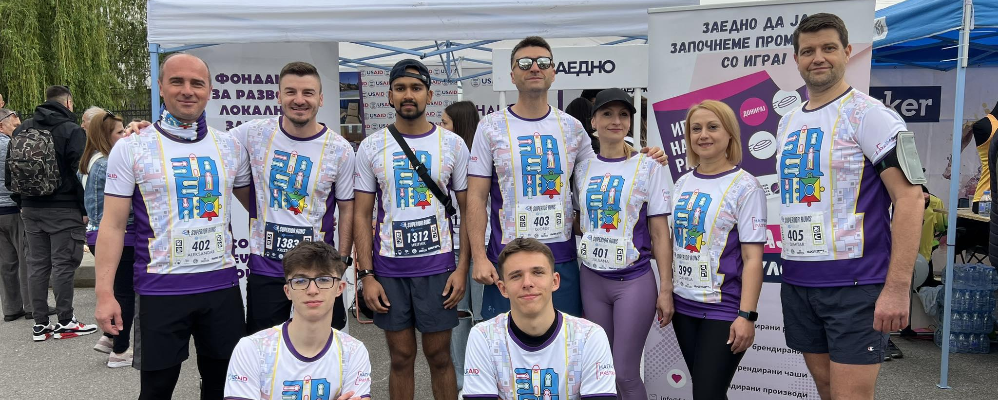
KEY RESULTS
ACCOMPLISHMENTS
A total of six Community Colleges and six Youth Banks were established in the Municipalities of Stip, Kocani, Vinica, Delcevo, Makedonska Kamenica and Karbinci to increase effectiveness of local partnerships among local actors.
Municipalities have started addressing the needs and priorities of the community identified by Community colleges and youth banks. Already, 32 priorities have been addressed.
75 local community leaders were trained on fundraising and outreach.
Youth Banks are recognized as a replicable model for local youth led community development in the country.
Citizen and Stakeholder Engagement The activity established around 70 local partnerships with local actors. 32 locally lead initiatives were successfully implemented. 330 volunteers were involved in resource mobilization activities and implementation of the initiatives.
Resource Mobilization
Capacity Building
A total of $349,136 in non-donor resources was mobilized for local initiatives in active counterpart municipalities.
More than 100 youth were trained in community mobilization and civic activism, project cycle management and resource mobilization.
Last updated: October 2024

