Slide 1
Partnerships for Economic Growth
Goal
Increase the productivity of MSMEs to spur economic growth.
Duration
January 2023–January 2029
Total Funding
$11,000,000
Implementing Partner
Palladium International
Contact
Kristina Deriban Email kderiban@usaid.gov
CHALLENGES
Micro, small, and medium enterprises (MSMEs) in North Macedonia dominate the economy: 96 percent of all firms are MSMEs, accounting for 74 percent of all employment. However, their productivity is 80 percent below the European Union average. Businesses struggle to innovate, modernize, and fully utilize the country’s productive workforce. Additionally, the urgency to address global climate change and meet the EU’s Green Agenda emphasises the need for reduced greenhouse gas emissions and the promotion of sustainable, cleaner production methods.
Recognizing that MSMEs must play a major role in the country’s rapid, sustainable, broad-based growth, USAID is investing in partnerships to boost MSME productivity and competitiveness, while better integrating businesses into regional markets. USAID is supporting MSMEs, Business Support Organizations, policymakers, and government agencies in transitioning towards a "greener" economy.
ACTIVITY DESCRIPTION
This activity unlocks the growth, productivity, and employment potential of MSMEs, while fostering a more environmentally sustainable economy by: a) co investing funds, expertise, and technology to modernize operations, improve management practices, build workforce skills, and promote environmentally friendly production methods; b) facilitating increased access to financing through both traditional and alternative sources - including support for "green" investments - while enhancing investment readiness; and c) advocating and lobbying through the public-private dialogue platform. The Activity also addresses existing trade barriers and limitations to establish an environment conducive to regional economic trade and integration.
EXPECTED OUTCOMES
Increased mobilization of capital in MSMEs.
Improved public-private dialogue.
Improved management practices to increase access to finance.

Slide 2
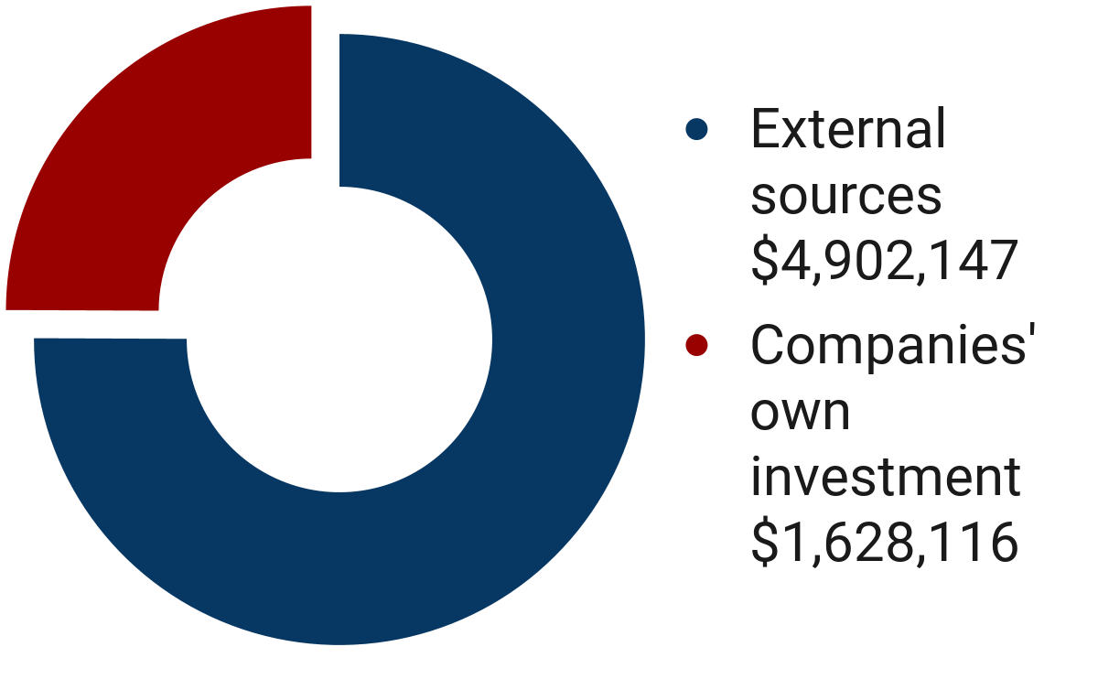
KEY RESULTS IN 2023
EXPECTED ACCOMPLISHMENTS
Increased Productivity 449 private sector firms engaged with USG support through project activities. 236 MSMEs assisted through lead company or direct increased productivity interventions.
MSMEs will mobilize and channel capital in modern solutions supporting the transition towards an environmentally sustainable economy.
Micro, small, and medium sized enterprises will have better financial management, enabling them to access finance.
Targeted public-private dialogue will address MSME challenges and barriers to growth, fostering compliance with EU regulations and standards.
The business environment will be more conducive to regional economic integration.
Improved Management
238 private sector firms reported improved management practice.
Total Capital Mobilized
$6,530,263
Increased Access
206 MSMEs Received USAID financial mentoring
45 MSMEs Successfully accessed finance
Leveraged Investments
$402,840 Of leveraged investments in supported MSMEs.
.
Last updated: October 2024

